Slide 1

Push Down Automata (PDA)
Tutorial 08
CSCI419 - Theory of Computing

Slide 2
What is it?!
Recognizes non-regular languages
Like NFA + Stack
Last-In-First-Out (LIFO)

Slide 3
How to describe a PDA?
Stack Alphabets
Initial State
(Q, ∑, t, ẟ, q, F)
Final States
States
Alphabets
Transition Table
Formal Description (6 – tuple)

Slide 4
Transition
Input, Pop, Push
S1
Input, Pop → Push
S2
a, $ → b
a, $, b

Slide 5
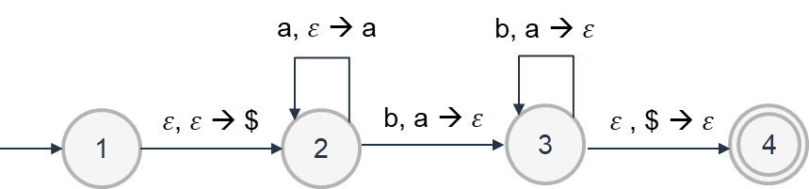
Example 1
M: L(M) = {a^{m} b^{m} | m>= 0}
ε, ε → ε

Slide 6
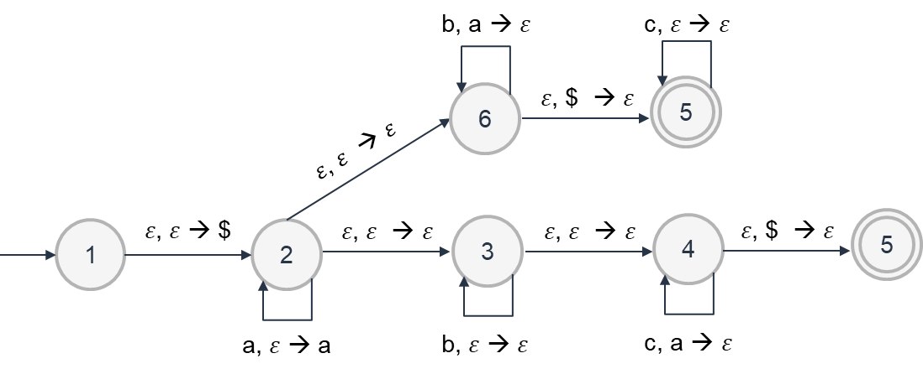
Example 2
M: L(M) = {a^{i} b^{j} c^{k} | i, j, k >= 0 and i = j or i = k}

Slide 7
Now, let’s try to covert CFG to PDA

Slide 8
Steps
Push $ to Stack
Push Start Symbol to stack
Pop/Push Variables in the main loop
Pop/Push terminals in the main loop
Match $ to move to accept state

Slide 9
Example 3
Push $ to Stack
S → aTb | b
T → Tb | ε
ε, ε → $
1
2

Slide 10
Example 3
Push Start Symbol to stack
S → aTb | b
T → Tb | ε
ε, ε → $
ε, ε → S
1
2
3

Slide 11
Example 3
Pop/Push Variables in the main loop
S → aTb | b
T → Tb | ε
ε, ε → T
4
5
ε, S → b
ε, ε → a
ε, ε → $
ε, ε → S
ε, T → b
1
2
3
6
ε, ε → T
ε, S → b
ε, T → ε

Slide 12
Example 3
Pop/Push Terminals in the main loop
S → aTb | b
T → Tb | ε
ε, ε → T
4
5
ε, S → b
ε, ε → a
ε, ε → $
ε, ε → S
ε, T → b
1
2
3
6
ε, ε → T
ε, S → b
ε, T → ε
a, a → ε
b, b → ε

Slide 13
Example 3
Match $ to move to accept state
S → aTb | b
T → Tb | ε
ε, ε → T
4
5
ε, S → b
ε, ε → a
ε, ε → $
ε, ε → S
ε, T → b
1
2
3
6
ε, ε → T
7
ε, $ → ε
ε, S → b
ε, T → ε
a, a → ε
b, b → ε

Slide 14
Task (in Lab 1)
Construct PDA for the below grammar:
S → AB
A → aAb | ε
B → cB | ε
Test on the PDA
aabbc
abab
Solve on paper, write your name and ID

Slide 15
Task (in Lab 2)
Construct PDA for the below grammar:
S → AB
A → aA | ε
B → bB | ε
Test on the PDA
aabb
abab
Solve on paper, write your name and ID

Slide 16
THANK
YOU

